Slide 1
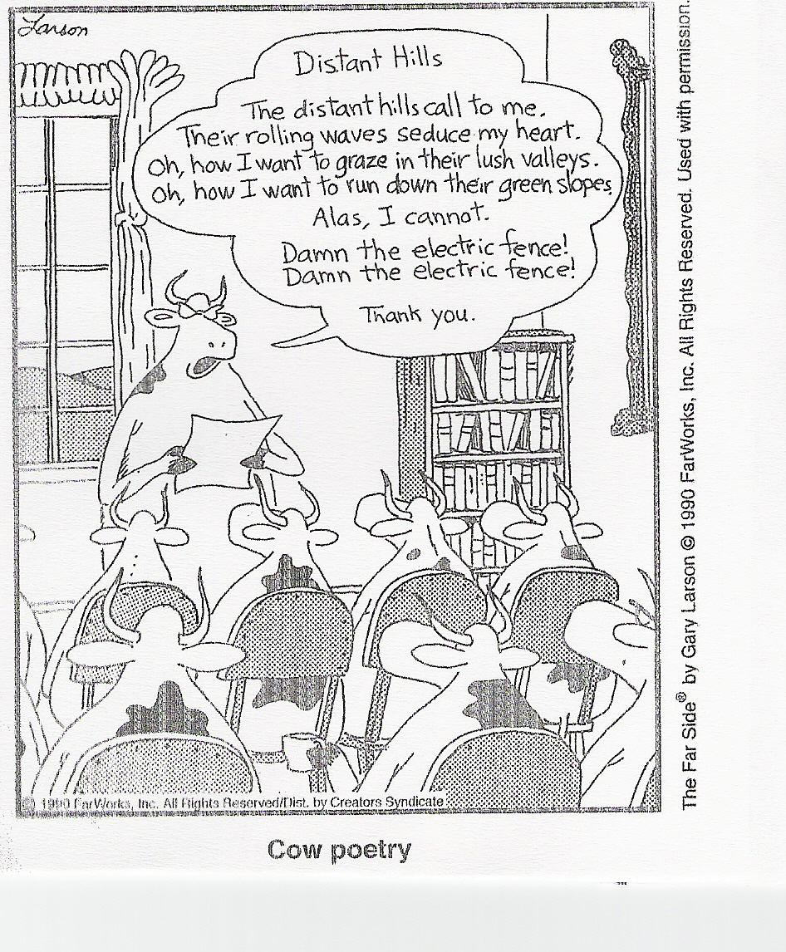
Cow Poetry by Gary Larson

Slide 2
Lit Center Mini Lesson Fall 2013
Sentence Fluency
Fluent writing is varied, graceful, rhythmic, almost musical—natural cadence
Easy to read aloud
Sentences are well built; they move
Varied in structure and length; beginnings vary
Marked by logic, creative phrasing, parallel construction, alliteration, and word order

Slide 3
The Midnight Ride of Paul Revere
Listen, my children, and you shall hear
Of the midnight ride of Paul Revere,
On the eighteenth of April, in seventy-five;
Hardly a man is now alive
Who remembers that famous day and year.
He said to his friend, “If the British march
By land or by sea from the town tonight,
Hang a lantern aloft in the belfry arch
Of the North Church tower as a signal light-
One, if by land, and two, if by sea;
And I on the opposite shore will be,
Ready to ride and spread the alarm
Through every Middlesex village and farm,
For the country folk to be up and to arm.”
Notes:
Grade 5 Read Aloud Theme 3
Model a variety of ways to choral read (see packet for handout)
Teacher read-aloud
Voice in-voice out
Ascending and descending voices

Slide 4
The Raven By Edgar Allan Poe
(recited by Christopher Walken)
And the Raven, never flitting, still is sitting, still is sitting
On the pallid bust of Pallas just above my chamber door;
And his eyes have all the seeming of a demon's that is dreaming,
And the lamplight o'er him streaming throws his shadow on the floor;
And my soul from out that shadow that lies floating on the floor
Shall be lifted - nevermore!
http://www.ojai.net/swanson/theraven.htm
Notes:
Read aloud—open discussion to sentence fluency examples
Long/short sentence
rhythme, cadence

Slide 5
Masterpiece Sentences
Jane Fell Greene
Language!
A Five Steps Process
Sentence
Elaboration
Louisa Moats

Slide 6
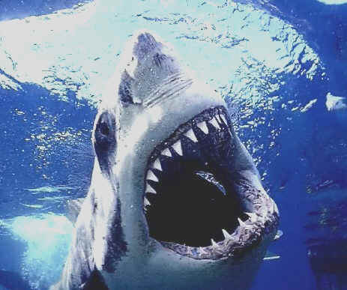
A shark = base subject
(Who did it?)

Slide 7
bit = base predicate
(What did it do?)

Slide 8
A shark bit.
Paint the predicate
  How? with his sharp teeth
  When? in the daylight
  Where? at the surface
  How much? over and over
  How many? five swimmers
  How often? on Tuesday

Slide 9
The shark bit with his sharp teeth in the daylight at the surface over and over five swimmers on Tuesday.

Slide 10
Move the Predicate Painters…
On Tuesday the shark, with his sharp teeth, bit five swimmers over and over at the surface in the daylight.

Slide 11
Paint the Subject…
The great white shark, master of the ocean,

Slide 12
Reconsider Word Choices…
The great white shark, master of the ocean,
On Tuesday the shark, with his sharp teeth, bit five swimmers over and over at the surface in the daylight.
Bit → chomped
Over and over → repeatedly
In the daylight → of the brightly lit water

Slide 13
Apply Finishing Touches…
Refine wording
Move sentence parts
Check spelling
Check punctuation
On Tuesday, the great white shark, master of the ocean, repeatedly chomped his sharp teeth into five swimmers at the surface of the brightly lit water.

Slide 14
Start With a
“Kernel Sentence”
1
Herbert spat.
Subject
Predicate

Slide 15
Paint the Predicate
(Complex Sentences
& Varied Details)
2
Subject
Herbert spat at the visitors who came too close to his cage during his afternoon meal.
1 at a time
Painted Predicate
(how, where, when, why)

Slide 16
Move the
Predicate Painters
(Varied Sentence Structure)
3
During his meal, Herbert spat at the zoo visitors who came too close to his cage.
Subject
Predicate
Moved / Broken-up

Slide 17
Paint the Subject
4
During his meal, Herbert, the aging orangutan, spat at the zoo visitors who came too close to his cage.
Painted
Subject
Predicate
Moved / Broken-up

Slide 18
Substitute Better Words and Add Detail
5
Munching peacefully on a banana, Herbert, the aging orangutan, spat at the curious visitors who approached his cage.
Explicit Detail
Better Words

Slide 19

Sentence Elaboration
Go through the following five steps to come up with an elaborate sentence.
Start with a kernel sentence
Paint the predicate
Move the predicate painters
Paint the subject
Substitute better words and add details

Slide 20
Sentence Sense
Rearrange the following words to make a complete sentence that sounds right.
Word
Anagrams
senses
if
danger
the
small
will
fish
it
hide
The small fish will hide if it senses danger.
If it senses danger, the small fish will hide.
Will the small fish hide if it senses danger?

Slide 21

Sentence Stretching
Stretch a sentence found in text, or created by the student, to make the sentence more “interesting”. This is done by changing one word in each new sentence.
Example: Matthew ate the pizza.
  Matthew snarfed the pizza.
  Matthew snarfed the cheesy pizza.
  Matthew snarfed the cheesy, steamy pizza.
  Greedily, Matthew snarfed the cheesy, steamy pizza.

Slide 22
A FEW MORE SUGGESTIONS FOR TEACHING AND PRACTICING SENTENCE FLUENCY…

Slide 23
SENTENCE COMBINING
A simple, but useful, technique to create longer, more interesting sentences from a series of short choppy ones.
Tia Myrna went shopping on Saturday.
Tia Myrna went out to lunch on Saturday.
Tia Myrna went to the movies on Saturday.
Tia Myrna went shopping, out to lunch, and to the movies on Saturday.
Tia Myrna didn’t get to go shopping on Saturday, but she did get to go out to lunch and to the movies.
USE JUDICIOUSLY

Slide 24
Sentencing Combining
He smeared his face with red paint and
lampblack.
He pulled a tight stockinglike
covering over
his head.
He draped a ragged blanket over
his shoulders.

Slide 25

Which is Better?
Students will look at two versions of the same piece of writing and will be able to distinguish which piece maximizes meaning, focusing on sentence formation, hearing how the words play to the ears and eyes, and feeling the phrases as it leads them through the piece.
Example:
1.One should make up short, choppy sentences.
Benny walked onto the stage. He raised his trumpet to his mouth. He waited for the cue.
2. And the other, one continuous sentence
Benny walked onto the stage, raised his trumpet to his mouth, and waited for his cue.

Slide 26
Use textbook samples, newspaper articles, and student writing to find sentences that can be pruned.
Discuss with your students how sometimes cutting a sentence down to a more manageable size without changing the meaning might be useful.

Slide 27
EXAMPLE
The stadium has ample parking space available for fans’ automobiles.
Lean and Mean
The stadium has ample parking
space.

Slide 28

Discussion Guide
When I read my paper, can I hear or feel the flow and rhythm?
Do my sentences begin in different ways?
Are my sentences of different lengths?
Can the reader read my writing aloud with fluency?
Did I use dialogue? If yes, does it sound like real people are talking?
Students need to think & reflect
like writers.

