Slide 1



Six Traits Plus
WORD CHOICE
& VOICE FOCUS
Lit Center
Mini Lesson
Fall 2013

Slide 2

A THOUGHT TO CONSIDER
“If people cannot write well, they cannot think well, and if they cannot think well, others will do their thinking for them.”
  George Orwell
Notes:
This Ppt. will briefly review 6 Traits, the focus on Word Choice (also see Sentence Fluency) and the Voice overview, ending with RAFTS prompts review.

Slide 3
6 Traits+ Writing
Not a program
Not an additional task
A new way of empowering/promoting students as writers
Removes the burden of constantly being the editor of student work
Thrusts back upon the students the task of revision
Opportunity for students to engage in rigorous and relevant tasks

Slide 4



Six Traits Plus
Ideas… the heart of the message
Organization…internal structure,
thread of meaning
Voice… the soul of the piece
Word Choice…rich. Colorful and precise language
Sentence Fluency…the music of the piece ♬♪♫
Conventions…level of correctness
+Presentation
Notes:
Ideas where we spend most of the time
Organization…THE SRUCTURE of text…. what we fail to go beyond

Slide 5

Ideas
Ideas… the heart of the message
What makes the essence of the composition
Where we spend the bulk of our time with students
Read
Talk
Think
Requires evaluation and synthesis

Slide 6
Organization
Organization…internal structure,
thread of meaning ….
skeleton of writing….
Difficult trait for students-
More worried about correctness
than content
Confusion – include or not include?
Genre specific issues hard to navigate
Rigidity – follow known format

Slide 7

Conventions
Conventions…level of correctness
Are for the reader, a gift from the writer
Where teachers expend much energy
What students fear most
Best taught in context of real writing and followed up with mini-lessons for specific purposes

Slide 8



Voice
It is the person behind the words
Flavor of a piece
It is the extension of one’s self in a work
A bridge between the writer
and his or her reader
Recognized as a gift in our society

Slide 9

FOCUS
ON
WORD CHOICE

Slide 10
Reflect on a time when words impacted your life…
Times of
  Trouble
  Doubt
  Happiness
  Can you remember a time when words changed your way of thinking? Caused you to change your actions? Make decisions?

Slide 11
Word Choice
adjectives
adverb
Many writers and editors feel that verbs are the most important part of speech when it comes to strengthening both voice and word choice.
“Verbs are the most important of all your tools. They push the sentence forward and give it momentum…fail, poke, dazzle, squash, beguile, pamper, swagger, wheedle, vex.”
        William Zinsser
noun
verbs

Slide 12
WHAT DO WE MEAN BY WORD CHOICE?
Word choice is power
We are measured by what we say almost as often as what we do
Clear, precise, colorful
Vivid, rich
Energizing verbs
Memorable images

Slide 13

WHERE DO WE SEE WORD CHOICE?
In descriptive pieces and narratives to a certain degree, word choice is that which moves us beyond the general, “She is nice.”
Get us as readers to see, experience or know an object, person, place or time, using sensory details.

Slide 14

WORD CHOICE IN NARRATIVES
Structurally, a solid beginning, middle and end are foundational, so to move narratives from a simple recounting or retelling of a series of events to a story that needs to be retold, word choice becomes critical to our desire to read on and feel what the writer experienced.

Slide 15

IN EXPOSITORY WRITING
Precise, technical and academic words become important to help the readers understand the knowledge of the writer about the topic.

Slide 16
IN PERSUASIVE WRITING
Words, especially strong, clear verb choices become important to advance a writer’s argument.
All good persuasive pieces end with a call to action showcases the need for precise, powerful words.
Carefully chosen words moves the reader to see one’s point of view as plausible.

Slide 17
HOW DO WE HELP STUDENTS WITH
WORD CHOICE?
Explicit vocabulary instruction
Text Talk
Great Literature
Read Alouds
Many varied opportunities to practice with words orally and in writing
Practice assessing student work samples – both good and bad

Slide 18
INTERMEDIATE
Experimentation with precise words, strong verbs.
Incorporation of instructed vocabulary into speech and writing
Development of narrative as a canvas to highlight descriptive words
Movement from oral language or social register towards written or academic register

Slide 19


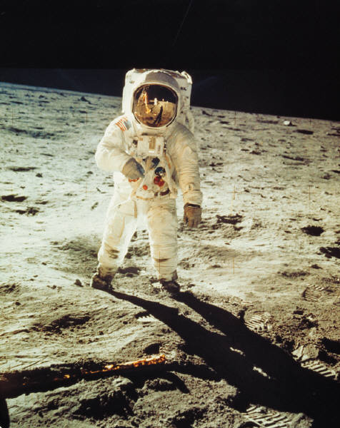
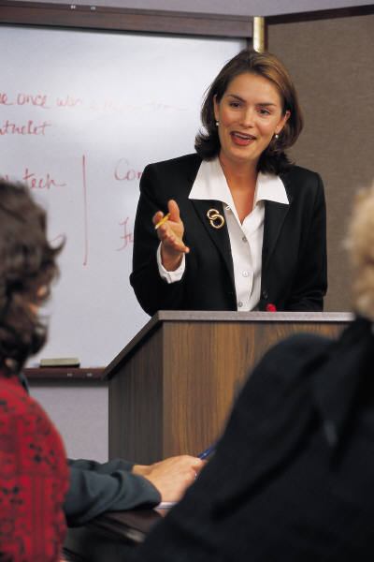
FOCUS ON VOICE

Slide 20
VOICE IS FOUND…
In all of the arts
In the selection of the books we read
In the programs we watch, the movies we see, the art we appreciate
In the talks and ideas we
share

Slide 21

Voice is situational
Voice is context specific
  Imagine the difference in voice in a note:
    Telling an employee that he or she is being fired, and one reminding your son or daughter to pick up clothes off the bedroom floor
Voice is different for each purpose and should be appropriate for the reader
Voice can be present in informational text most notably through the use of metaphors

Slide 22

What stops voice?
Fear…afraid to let true feelings be revealed.
The “I don’t know, I don’t care” attitude
Our practice of always writing the same thing for the same person…us!

Slide 23

How do we foster voice?
READ! READ! READ! Great literature
Stop students when they are reading books and ask them why they like the book
Highlight how you understand what the author is like while reading text selections

Slide 24
RAFTS
An acronym that stands for:
  Role…what the student’s perspective is
  Audience…for whom the piece is being written
  Format…how the writing will take shape
  Topic…what the writing is about
  Strong Verb…academic word that evokes a certain type of word use in the piece

Slide 25
RAFTS Example
Role: heart
Audience : Your human body
Format: letter
Topic: What you need to do to keep me healthy
Strong verb: explaining

Slide 26
A RAFTS prompt would look like this…
You are your own heart and you will write a friendly letter to your body explaining what it needs to do to keep you healthy.

Slide 27

“We must teach ourselves to recognize our own voice. We want to write in a way that is natural for us, that grows out of the way we think, the way we see, the way we care. But to make that voice effective we must develop it, extending our natural voice through the experience of writing on different subjects for different audiences, of using our voice as we perform
many writing tasks.”
Donald Murray, Write to Learn

